Slide 1
Git Experience
I have used git in my under grad and other version control software at work.
It has been a while since I have used it on my Mac and was rather complicated when I tried to set it up using Terminal to be able to clone my repo and get my ssh keys working. I found it easier to just use the git desktop for all my git commands.
I also Learned in order to make a network diagram I had to make my repo public.

Slide 2
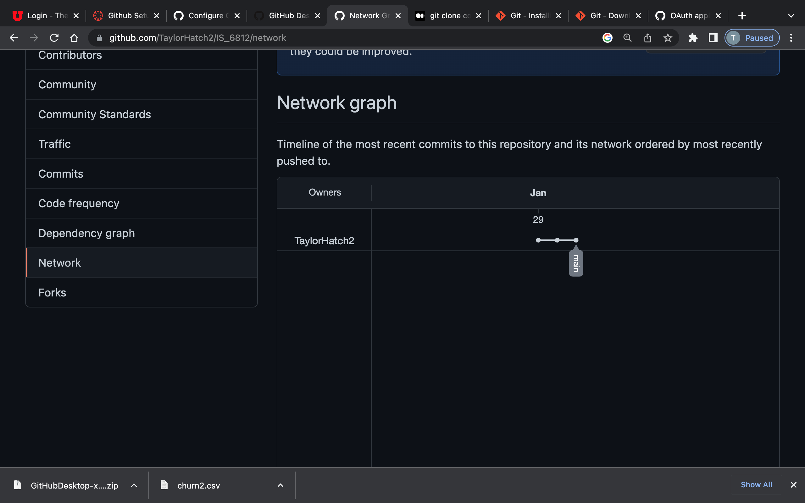
Network Diagram

Slide 3
